Slide 1
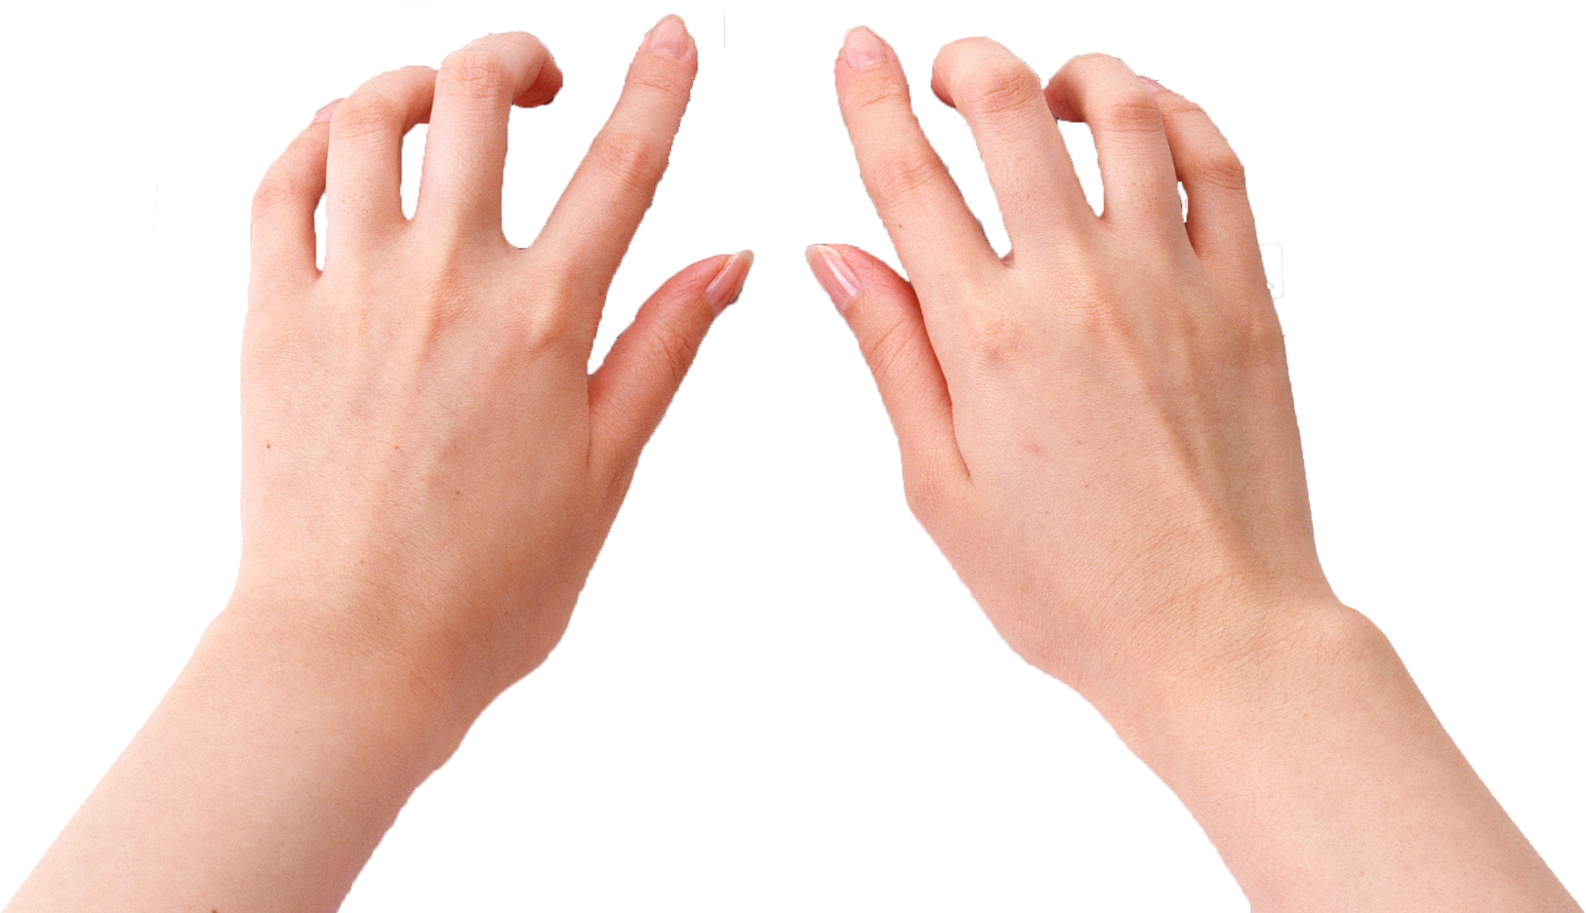
Invisible Keyboard
0411036 彭宣儒
0511088 曹立武
0511097 黃柏豪

Slide 2
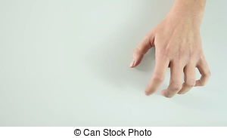
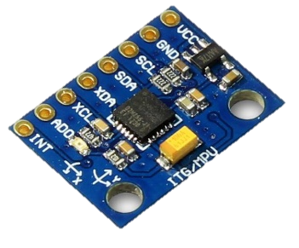
Background
Spying app
Use acceleration information to determine key user click.
Problem: sample rate of smartphone isn’t quick enough.
Arduino+MPU6050
MPU6050:a kind of g-senor, more high sample rate.
1
2
3

Slide 3
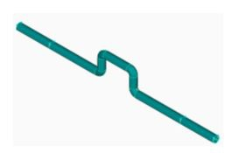
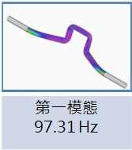
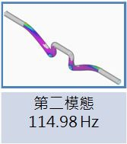
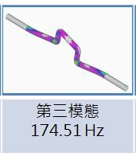
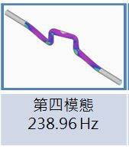
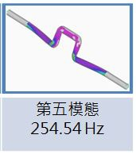
Background – mode of vibration
Everything has it own specific nature frequency.
One thing will have many different nature frequency called mode of vibration
The mode of vibration is depends only on the shape of the thing, not where we click it.

Slide 4
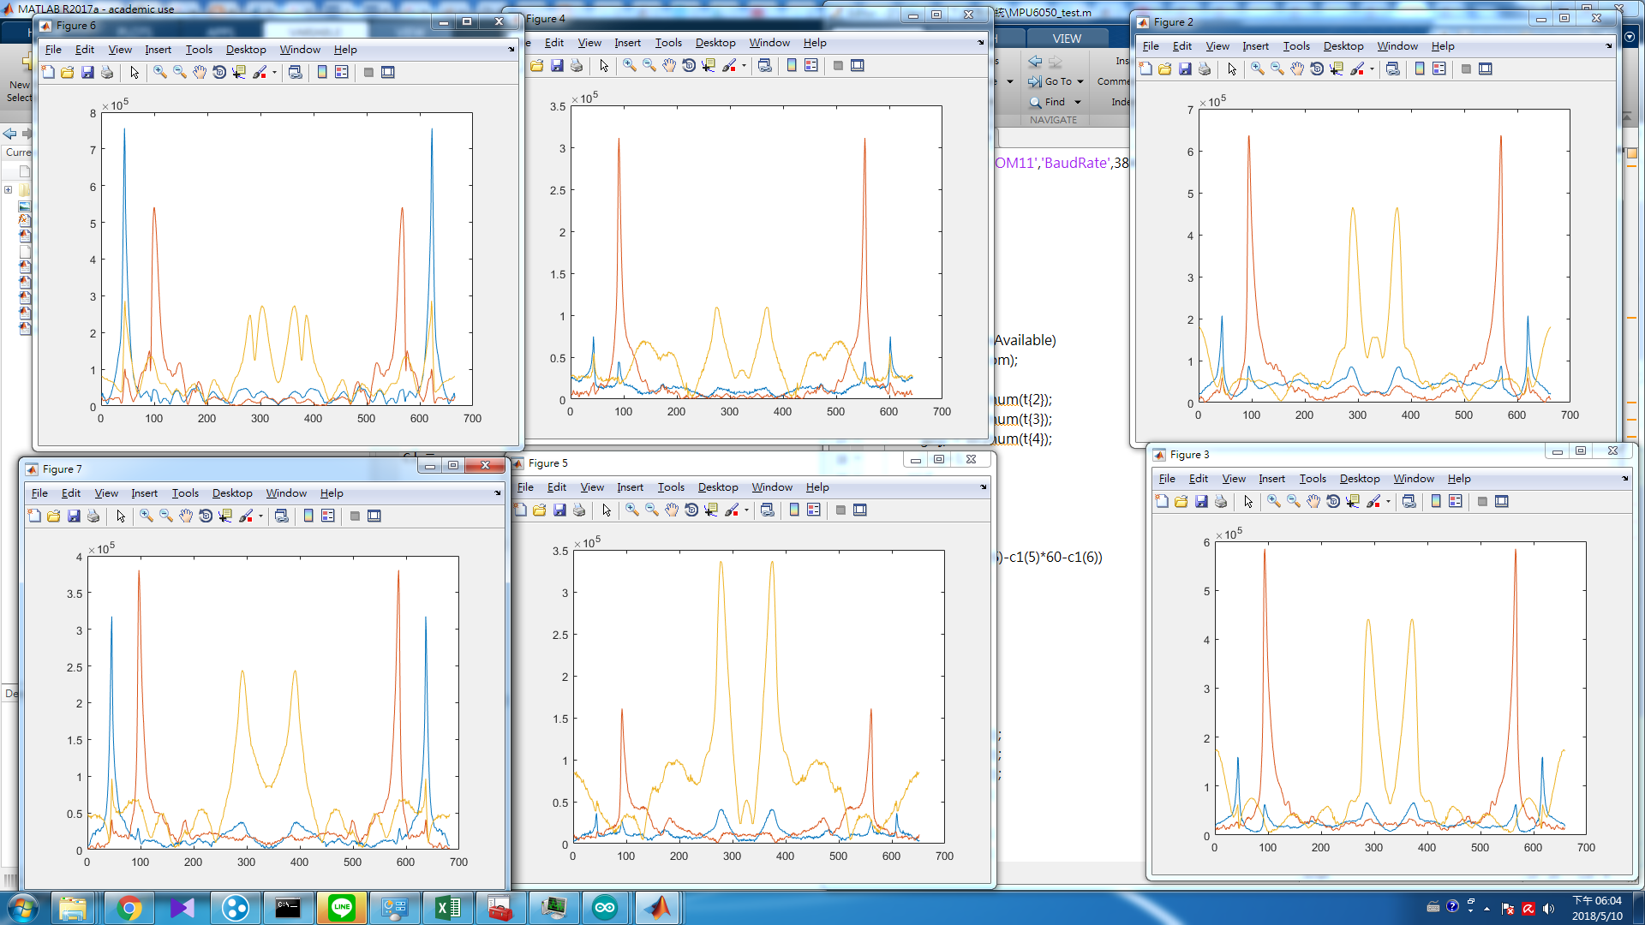
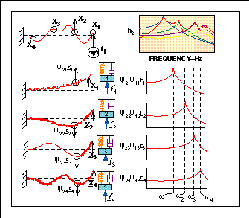
Background – signal in frequency domain
Use the relative magnitude to distinguish different location we hit, not the location of the frequency.

Slide 5
Joke
Why we know lot about vibration?
Cause we all from Mechanical Engineering.
No. Just a joke~~

Slide 6
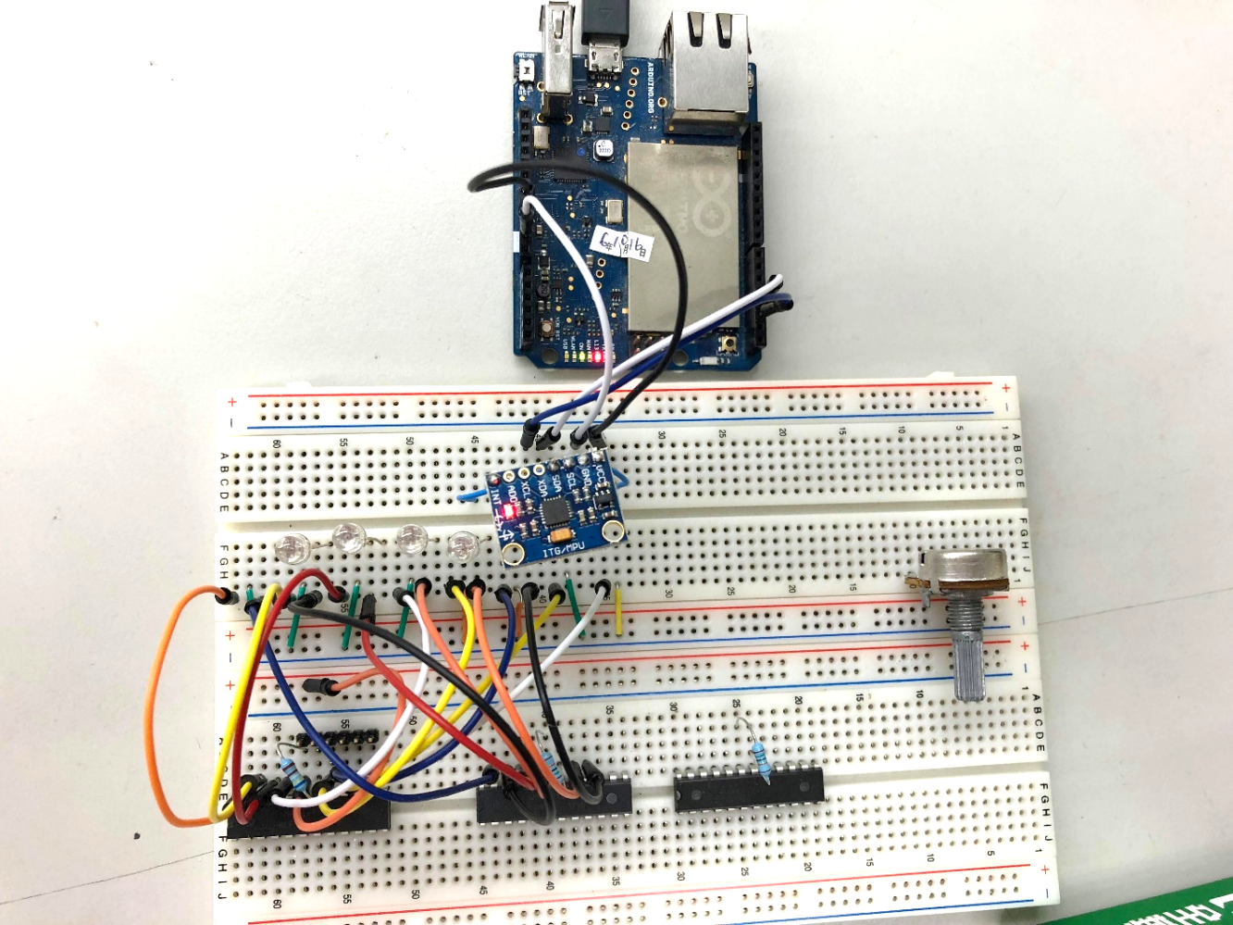
Hardware & Software
Hardware
ARDUINO
MPU6050
Software
Arduino IDE
i2cdevlib
Matlab
fft
Python
numpy
Keras

Slide 7

Architecture
PC
Matlab
Serial
.csv
I²C
Python
Keras
MPU6050

Slide 8
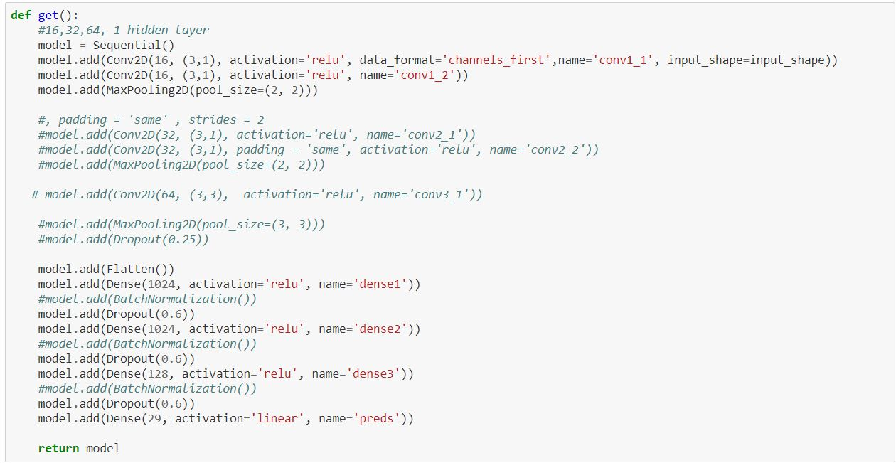
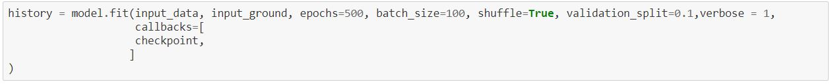
Some codes about CNN &DNN

Slide 9
Joke
A police officer stops a car. Officer: “Your driver’s license please.” Driver: “I’m really sorry, I forgot.” Officer: “At home?” Driver: “No, to do it.”

Slide 10
Execution plan
 | Week 1 5/7~5/13 | Week 2 5/14~5/20 | Week 3 5/21~5/27 | Week 4 5/28~6/3 | Week 5 6/4~ presentation
Ideas about project & make it work for data acquisition
More data & data pre-processing & build model & some results
Tunning for better performance
Collecting results for final project & making it into a report

Slide 11
Details(5/7~5/13)
Some ideas about project
Which vibration material are we going to choose?
Does it affect our performance on different tapping materials?
How many keys are we going to make?
4 directions? 8 directions? Any directions we want?
Data acquisition
Using Arduino + MPU6050 for better sample rate to collect data
That’s why we didn’t use Matlab mobile, however, we’ll try if it still have good performance with lower sample rate

Slide 12
Details(5/14~
Data pre-processing
Using python library numpy
Build model & Tunning for better performance
Many hyperparameters tunning and testing for different model structure with CNN, DNN, layers, nodes.

Slide 13
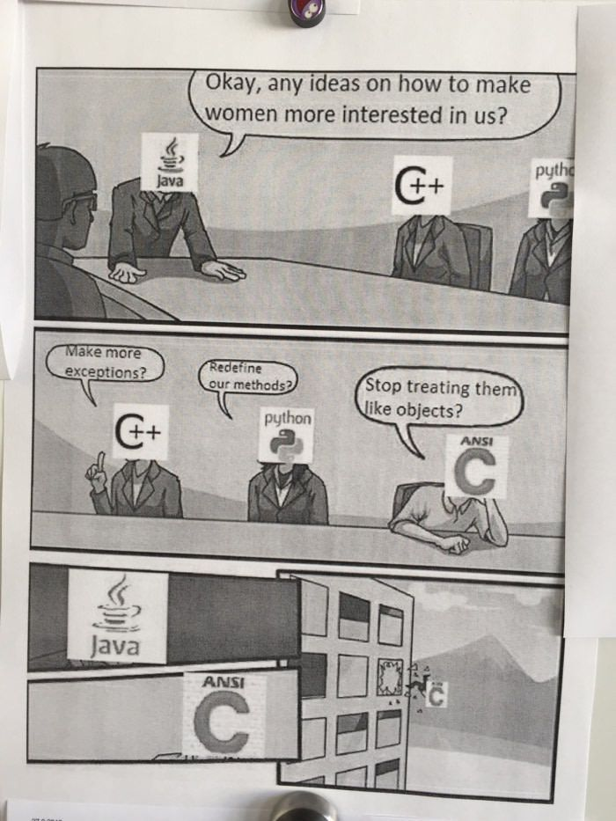
Redefine our method?
Make more exceptions?
Stop treating then like object?

Slide 14
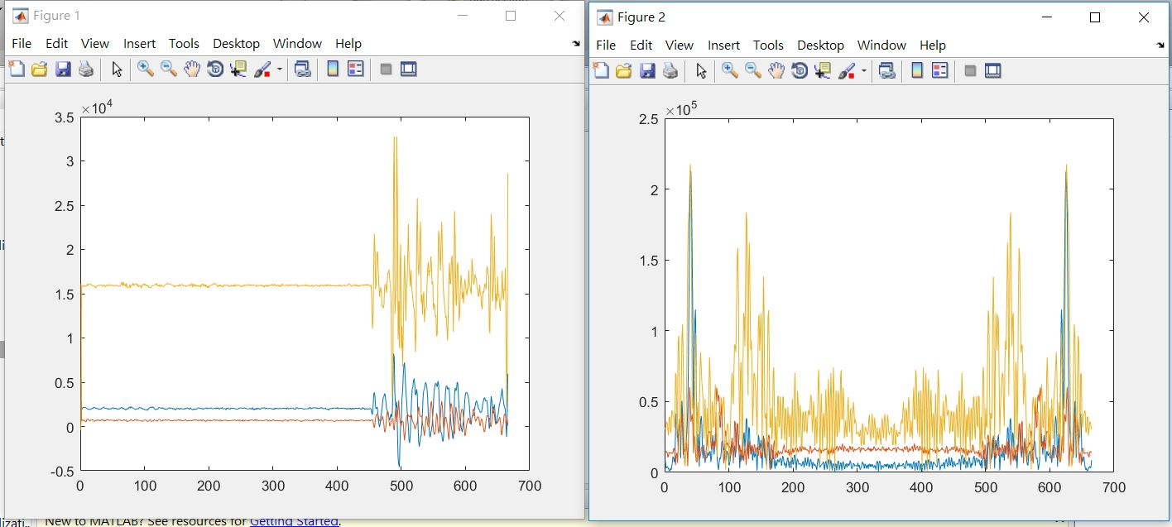
Preliminary results
Matlab (Raw data & Frequency data)

Slide 15
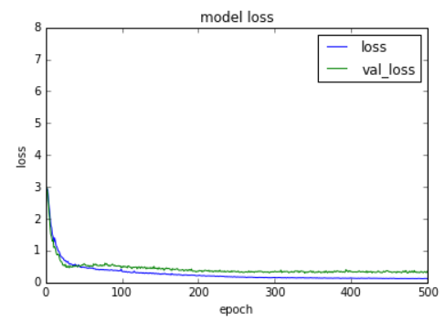
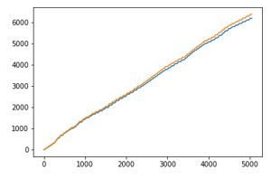
Python
some previous model experience with 6-axis sensor(data) & x_position(label)

Slide 16
